Slide 1
Denicek: Computational Substrate for
Document-Oriented End-User Programming
Tomas Petricek
Charles University, Prague, Czechia
tomas@tomasp.net
Jonathan Edwards
Independent, Boston, USA jonathanmedwards@gmail.com

Slide 2

Programming Experience Interactive Programming Environments
Programming 2025
Betty Jean Jennings
Margaret Hamilton
Adele Goldberg
Collaborative code & document editing
Live or incremental recomputation
W = random(100)
rect(W,10,yellow)
Todo List
☑ Write a paper
☑ Submit the paper
☑ Produce a video
Programming by demonstration
Structure editing with schema change control
Betty Jean Jennings
Margaret Hamilton
Adele Goldberg
=count(/ul/li)

Slide 3



Denicek
add
Denicek
add
edit
edit
wrap
wrap
add
add

Slide 4
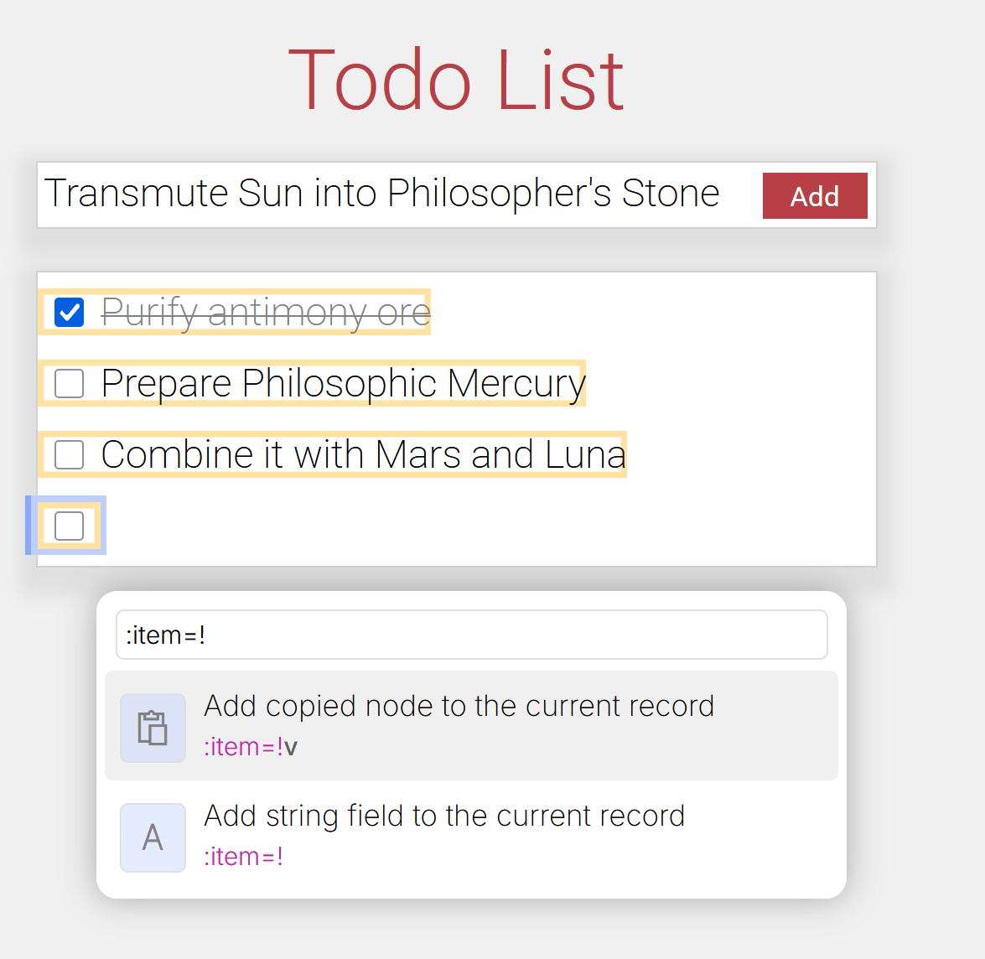
Webnicek
Denicek
add
edit
wrap
add
Design: Six formative examples in a simple web-based environment

Slide 5
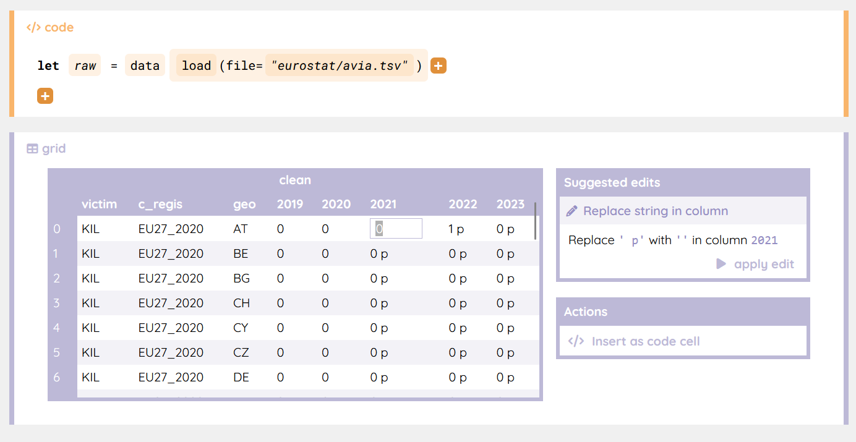
Webnicek
Datnicek
Denicek
add
edit
wrap
add
Design: Six formative examples in a simple web-based environment
Evaluation: Innovative data science notebook system

Slide 6
Programming Experiences
Collaborative Editing
Programming 2025
Betty Jean Jennings
Margaret Hamilton
Adele Goldberg
Todo List
☑ Write a paper
☑ Submit the paper
☑ Produce a video
W = random(100)
rect(W,10,yellow)

Slide 7
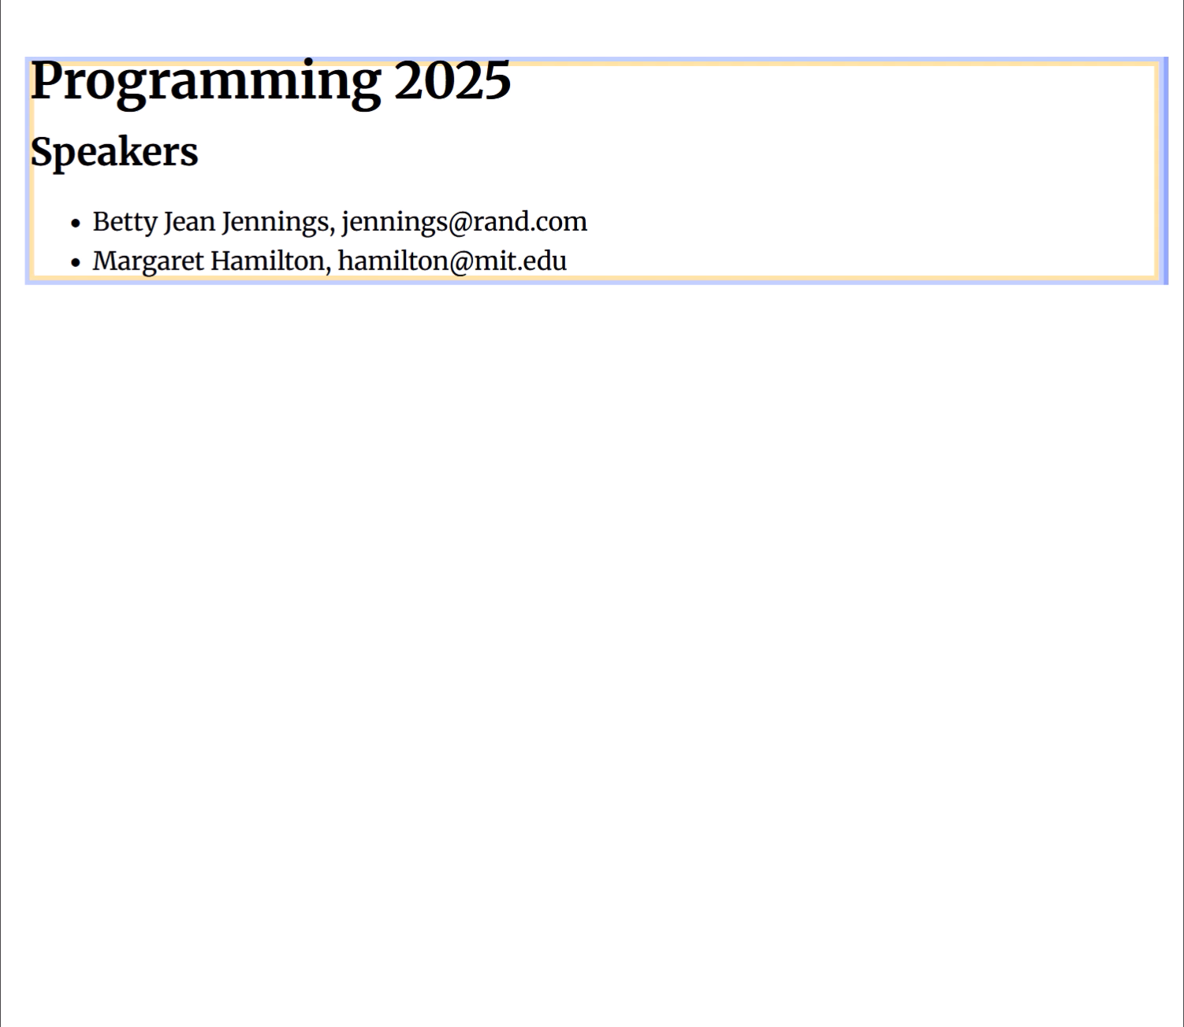
Programming 2025
Betty Jean Jennings
Margaret Hamilton
Adele Goldberg
Todo List
☑ Write a paper
☑ Submit the paper
☑ Produce a video
W = random(100)
rect(W,10,yellow)

Slide 8
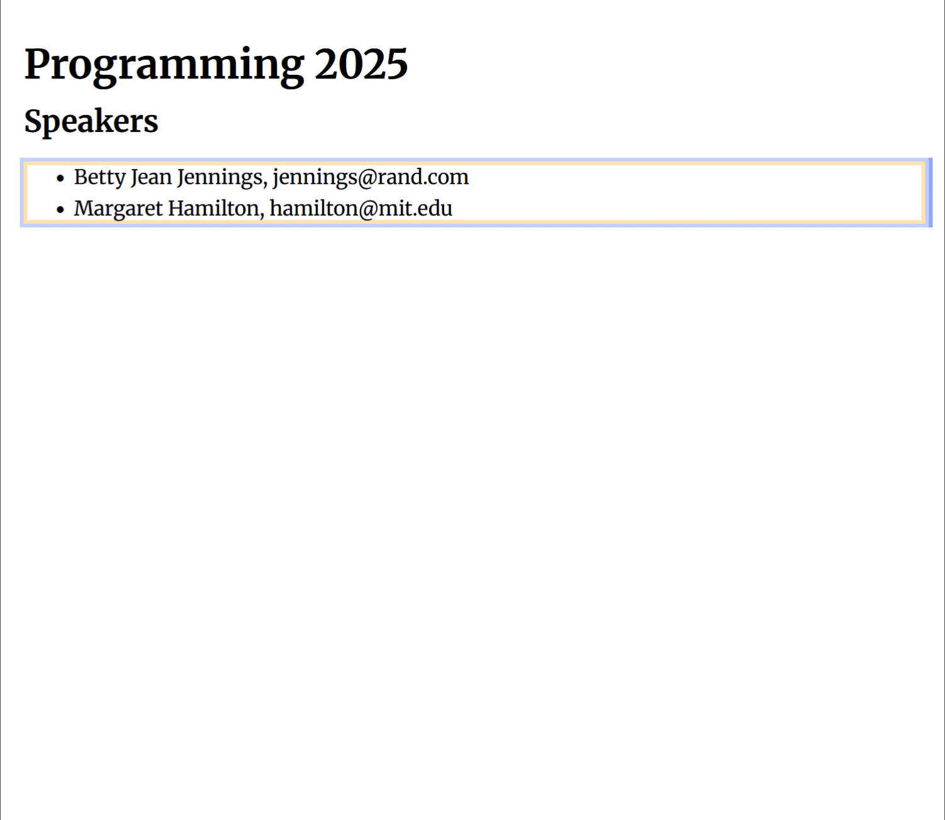
Programming 2025
Betty Jean Jennings
Margaret Hamilton
Adele Goldberg
Todo List
☑ Write a paper
☑ Submit the paper
☑ Produce a video
W = random(100)
rect(W,10,yellow)

Slide 9
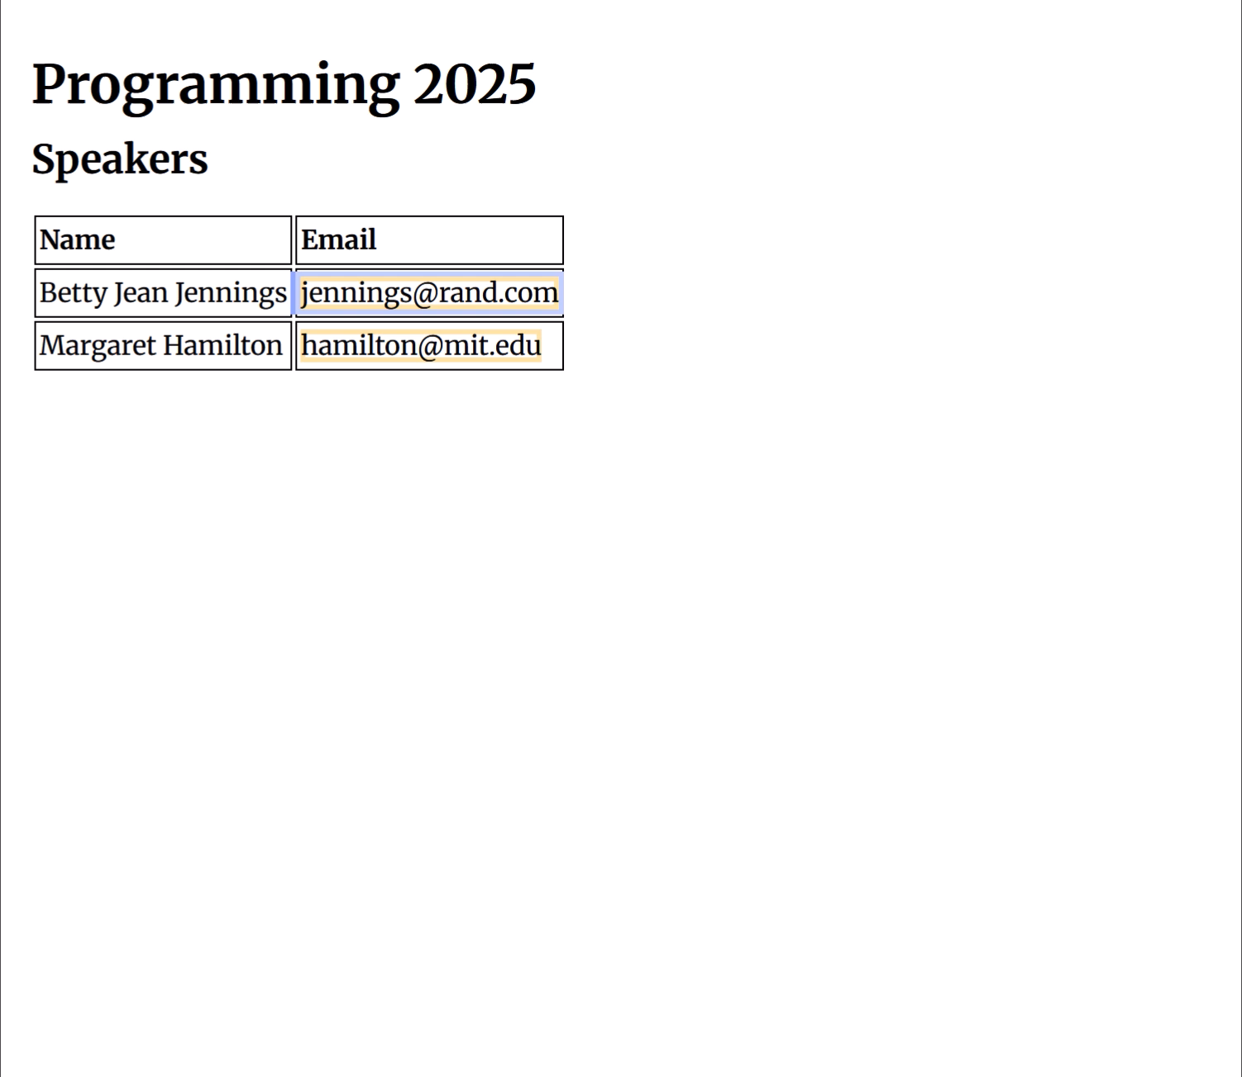
Programming 2025
Betty Jean Jennings
Margaret Hamilton
Adele Goldberg
Todo List
☑ Write a paper
☑ Submit the paper
☑ Produce a video
W = random(100)
rect(W,10,yellow)

Slide 10
Programming Experiences
Programming by Demonstration
Programming 2025
Betty Jean Jennings
Margaret Hamilton
Adele Goldberg
Todo List
☑ Write a paper
☑ Submit the paper
☑ Produce a video
W = random(100)
rect(W,10,yellow)

Slide 11
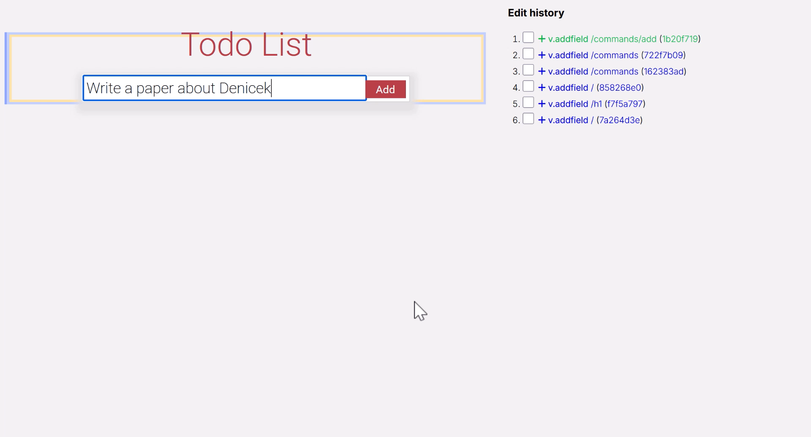
Programming 2025
Betty Jean Jennings
Margaret Hamilton
Adele Goldberg
Todo List
☑ Write a paper
☑ Submit the paper
☑ Produce a video
W = random(100)
rect(W,10,yellow)

Slide 12
Programming Experiences
Incremental Recomputation
Programming 2025
Betty Jean Jennings
Margaret Hamilton
Adele Goldberg
Todo List
☑ Write a paper
☑ Submit the paper
☑ Produce a video
W = random(100)
rect(W,10,yellow)

Slide 13
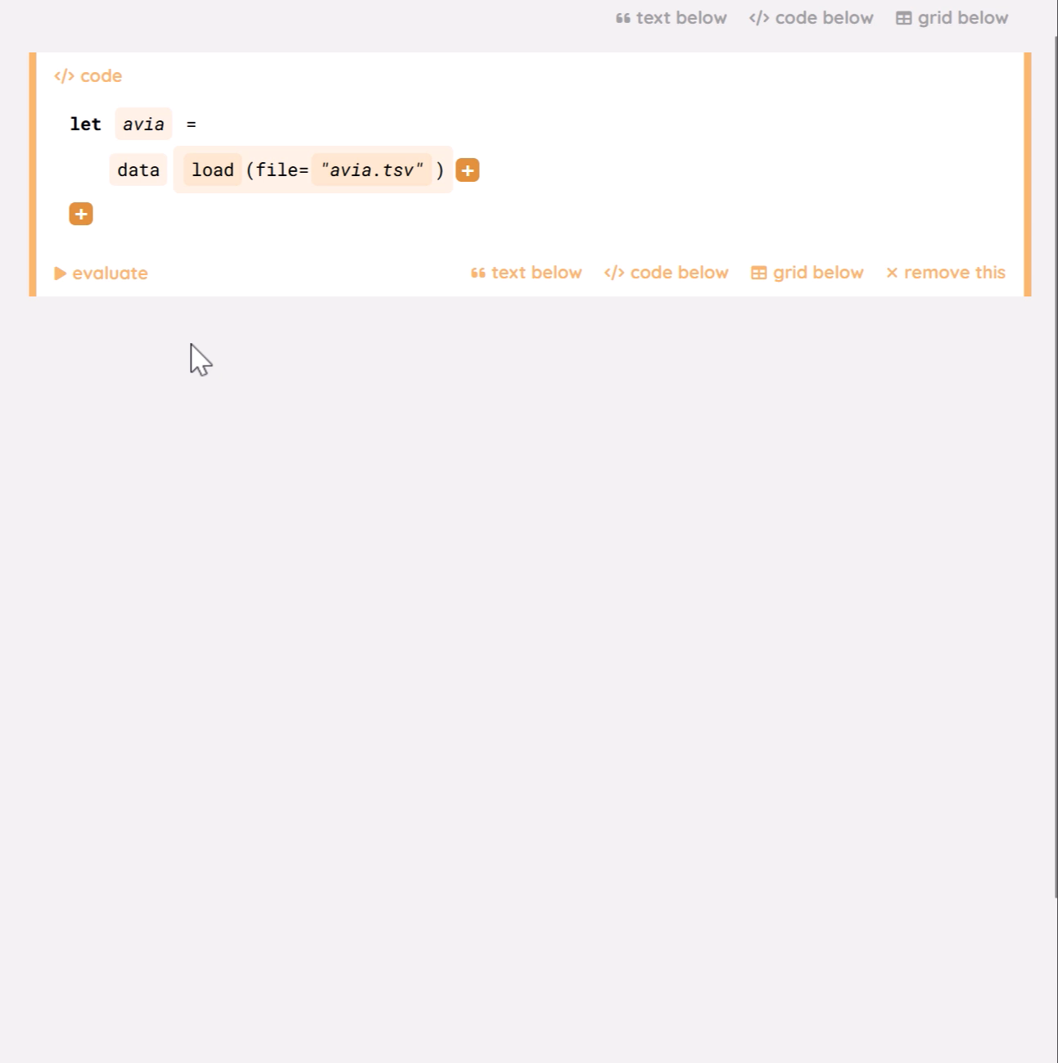
Programming 2025
Betty Jean Jennings
Margaret Hamilton
Adele Goldberg
Todo List
☑ Write a paper
☑ Submit the paper
☑ Produce a video
W = random(100)
rect(W,10,yellow)

Slide 14
The Denicek Computational Substrate
Programming 2025
Betty Jean Jennings
Margaret Hamilton
Adele Goldberg
Todo List
☑ Write a paper
☑ Submit the paper
☑ Produce a video
W = random(100)
rect(W,10,yellow)

Slide 15
Denicek: Edit History and Documents
Programming 2025
Betty Jean Jennings
Margaret Hamilton
Adele Goldberg
add
Todo List
☑ Write a paper
☑ Submit the paper
☑ Produce a video
edit
wrap
W = random(100)
rect(W,10,yellow)
add

Slide 16
Denicek: Merging Edit Histories
Programming 2025
Betty Jean Jennings
Margaret Hamilton
Adele Goldberg
Todo List
☑ Write a paper
☑ Submit the paper
☑ Produce a video
W = random(100)
rect(W,10,yellow)
wrap
add

Slide 17
Denicek: Merging Edit Histories
Programming 2025
Betty Jean Jennings
Margaret Hamilton
Adele Goldberg
Todo List
☑ Write a paper
☑ Submit the paper
☑ Produce a video
wrap
add
W = random(100)
edit
edit
rect(W,10,yellow)
wrap
add

Slide 18
Denicek: Merging Edit Histories
add
Programming 2025
Betty Jean Jennings
Margaret Hamilton
Adele Goldberg
edit
Todo List
☑ Write a paper
☑ Submit the paper
☑ Produce a video
wrap
W = random(100)
edit
rect(W,10,yellow)
wrap
add

Slide 19

Denicek: Edit Conflict Resolution
add
Reconcile compatible edits
add*
Programming 2025
Betty Jean Jennings
Margaret Hamilton
Adele Goldberg
edit
Report conflicting edits
edit*
Todo List
☑ Write a paper
☑ Submit the paper
☑ Produce a video
wrap
W = random(100)
edit
rect(W,10,yellow)
wrap
add

Slide 20
Unreasonable Effectiveness of Merging
Merge edits during collaborative editing
add*
Programming 2025
Betty Jean Jennings
Margaret Hamilton
Adele Goldberg
edit*
Todo List
☑ Write a paper
☑ Submit the paper
☑ Produce a video
Replay edits recorded during programming by demonstration
wrap
W = random(100)
Invalidate conflicting edits produced by formula evaluation
edit
rect(W,10,yellow)
wrap
add

Slide 21
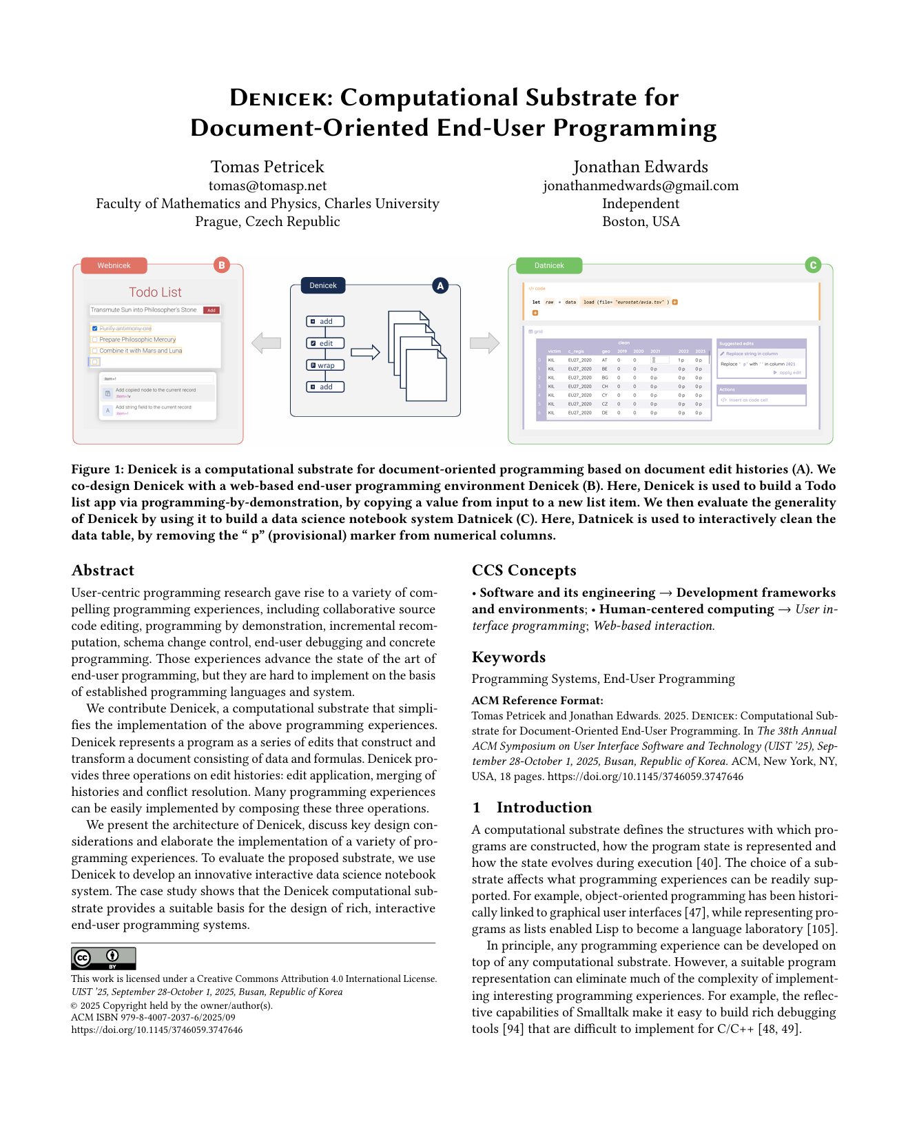
Programming 2025
Betty Jean Jennings
Margaret Hamilton
Adele Goldberg
Collaborative Editing
Todo List
☑ Write a paper
☑ Submit the paper
☑ Produce a video
Programming by Demonstration
W = random(100)
Incremental Recomputation
rect(W,10,yellow)

Slide 22


Programming 2025
Betty Jean Jennings
Margaret Hamilton
Adele Goldberg
Collaborative Editing
Todo List
☑ Write a paper
☑ Submit the paper
☑ Produce a video
Programming by Demonstration
W = random(100)
Incremental Recomputation
rect(W,10,yellow)
Tomas Petricek
tomas@tomasp.net
@tomasp.net

